Slide 1

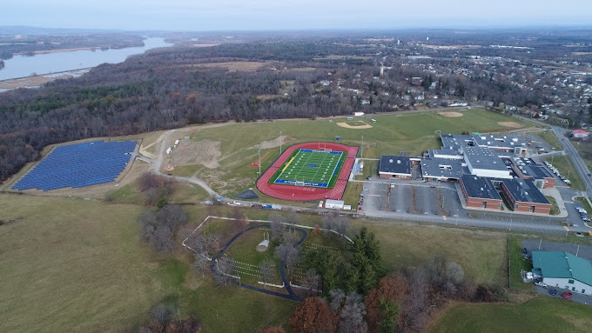

District Technology Updates & Overview of Smart Schools Investment Plan Recommendations
By: Dr. Pennyman-Superintendent, Cheryl Rabinowitz-Manager of Instructional Technology
January 7, 2025

Slide 2






How Do We Get There?
The Six Keys for School Improvement
 | Strengthen the Instructional Core |  | Strengthen Instructional Leadership Capacity
 | Improve Data Driven Practices |  | Tiered Approach to School Support & Intervention
 | Promote a Positive, Inclusive School Environment for all Stakeholders |  | Increase Monitoring & Accountability
Notes:
Cheryl

Slide 3
HCSD Technology Update for:
Technology Progress in the District (2020- 2025 School Years)
Student Tech Crew Overview
District Technology Committee & Plan
Overview of Smart Bond/Smart Schools Investment Plan (SSIP) Recommendations

Slide 4
Acknowledgements
For their collaboration & supporting technology for students and staff in the district, a special thank you to:
BOE Members, Superintendent, District and Building Administration, All Instructional and Non-Instructional Staff
Hudson CSD Community,Voters, Partners, Agencies
Hudson CSD Students and their families
District Technology Department
District Technology Committee
All our software and hardware Vendor Partners including the various BOCES (Questar & NERIC & Other BOCES)
Digital Promise,Verizon Innovative Learning Program

Slide 5
District Technology Updates (20-21, 21-22)
Installed New Network Switches at MCSES.
Upgraded the Server Room and Internet Provider.
Implemented Cybersecurity Training for all staff.
Upgraded desktops, laptops, chromebooks, classroom displays and installed an Apple lab at HS.
Hired 2 in-house Computer Service Specialist Technicians.
Centralized all software ordering and confirm it meets all NYS Ed Law 2D Requirements. (ongoing).
Media Center Equipment at MCSES.

Slide 6
District Technology Updates - (22-23, 23-24)
Upgraded Cabling in Network Closets.
Drafted a CyberSecurity Plan and Security Assessment with our BOCES Partners. (Ongoing)
Implemented a New Automated/Robocall Communication System; Parent Square & Implemented ThinkTech, Computerized Testing Simulation.
Upgraded Network Switches for JHS/HS/Central Office.
Rolled Out the Student Tech Direct Crew-Phase 1.
Upgraded more chromebooks and classroom displays.
Upgraded Camera System Software, Servers-Phase 1.
Implemented a new Helpdesk ticketing & Inventory system, Incident IQ for Technology and Facilities.
Implemented Wordly (Language Translation Program).
Assist district with pronunciations in eSchool Data.(ongoing)

Slide 7
District Technology Updates - (24-25)
Integrated Branching Minds, Achieve 3000, Atlas, Stafftrac with Classlink and eSchoolData.
Updated Cyber Security Awareness Training Program to CyberNut.
Implemented SWYE 360-Software Data usage program.
Kick Off for Verizon Innovative Learning Schools Program for JHS/HS (Chromebooks with cellular data, two instructional coaches, an additional technician, professional development, conferences).
Developed a Student/Family and Staff Technology Handbook.
Developing a Technology Newsletter.
Assist with Computerized Simulations & Testing.
Exploring more translation resources for students and staff.
Provided staff development on Superintendent’s Conference Day.
Working with District Technology Committee and Smart Schools.
Funding through (General Fund. eRate, Donations and Grants)

Slide 8
District Technology Snapshot
Staff Laptops: 230
Chromebooks: 3,286
Interactive Displays: 145
TV's: 35
Desktops: 66
All-In-One Desktops: 208
Monitors: 121
Printers: 95
Software Programs (Instructional, Administrative) approximate 130 programs, plus free programs (All NYS Ed Law 2D Compatible)
Dept. Staffing: IT Manager, 3 Computer Service Specialist Technicians, 1 Network Admin Engineer, Secretary
IT Dept. Focus is providing high quality IT Customer Support, Monitoring & Reflection (ongoing)

Slide 9
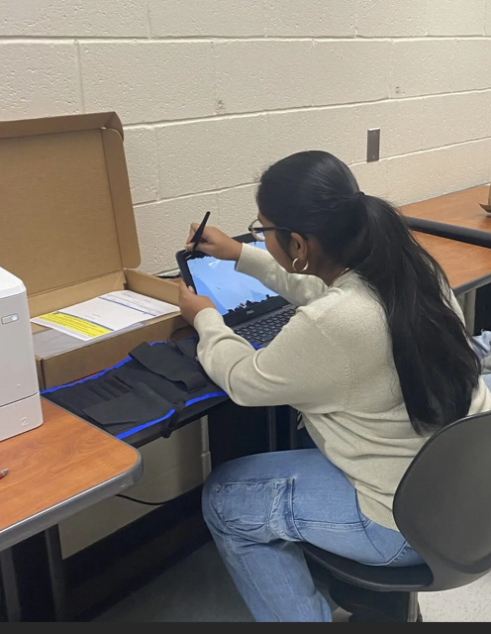
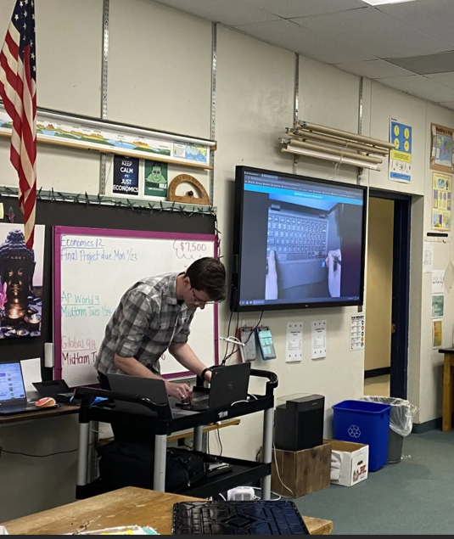
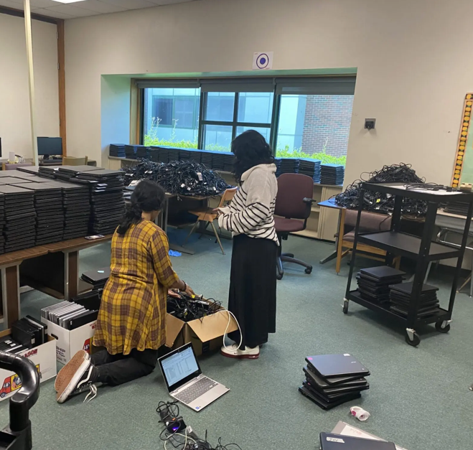
Student Tech Crew
Student Tech Crew-Cohorts: 1, 2 and 3 -Description of Cohorts:
Cohort 1: Grade 9-12 Students who are in year 3 of the program and have their Dell Computer Repair Certification.
Cohort 2: Grads 9-12 Students who are in year 1 and who need their Dell Computer Repair Certification.
Cohort 3: Grade 8 Students who are in year 1. Their focus is digital media announcements.

Slide 10
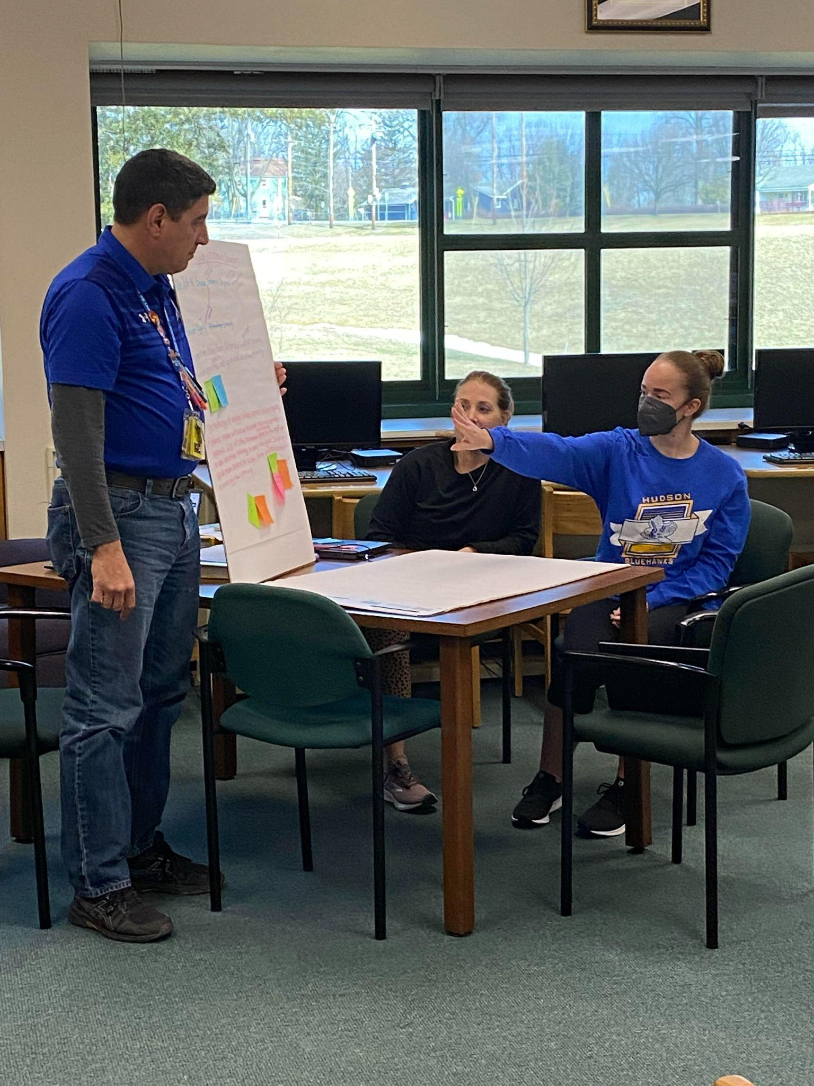
District Technology Committee Update:
HCSD has a Very Collaborative Working Committee, Comprised of Students, Parents/Guardian/Community & PreK-12 Faculty, Admin. Support Staff. A Special Thank You to the Committee for All Their Hard Work!
NYSED Requires School Districts to have a 3 Year Technology Plan. Current Plan covers three school years, 2022-2023, 2023-2024, 2024-2025.
Data Sources Used for Developing Plan:
IT Audit by the Comptroller’s Office.
Feedback from Technology Committee Surveys.
NYS Digital Equity Surveys.
IT Needs Assessments by IT Dept. & BOCES

Slide 11
Goal 1:
Provide appropriate instructional technology tools to the school community for teaching, learning, and productivity.
Completed Actions:
Provided chromebooks to students to support the instructional program.
Upgraded Laptops for staff.
Purchased Instructional Software.
Upgraded Interactive Displays for Classrooms and Offices.

Slide 12
Goal 2:
Provide professional development to teachers, administrators and support staff. Goal 3:
Ensure student proficiency in digital technology tools and digital citizenship literacy.
Actions:
Hired two Instructional Technology Coaches who assist with building capacity for technology integration, use of developing lessons that incorporate digital technology tools and digital citizenship literacy for students and are aligned with NYS Standards and National Educational Technology Standards.
IT Coaches provide embedded professional development to teachers by collaborative planning and modeling lessons in classrooms.
Continue to work with Building and District Leadership to provide professional development opportunities, during Superintendent Conference Days, After School and Summer Workshops.

Slide 13
Goal 4:
Ensure a fully functioning robust network with equitable, accessible and security technology.
Recommended Actions:
Upgrading wireless Network infrastructure
Upgrading the security camera system.
Upgrading the phone system.
Recommendation for using our Smart Schools Funding.

Slide 14
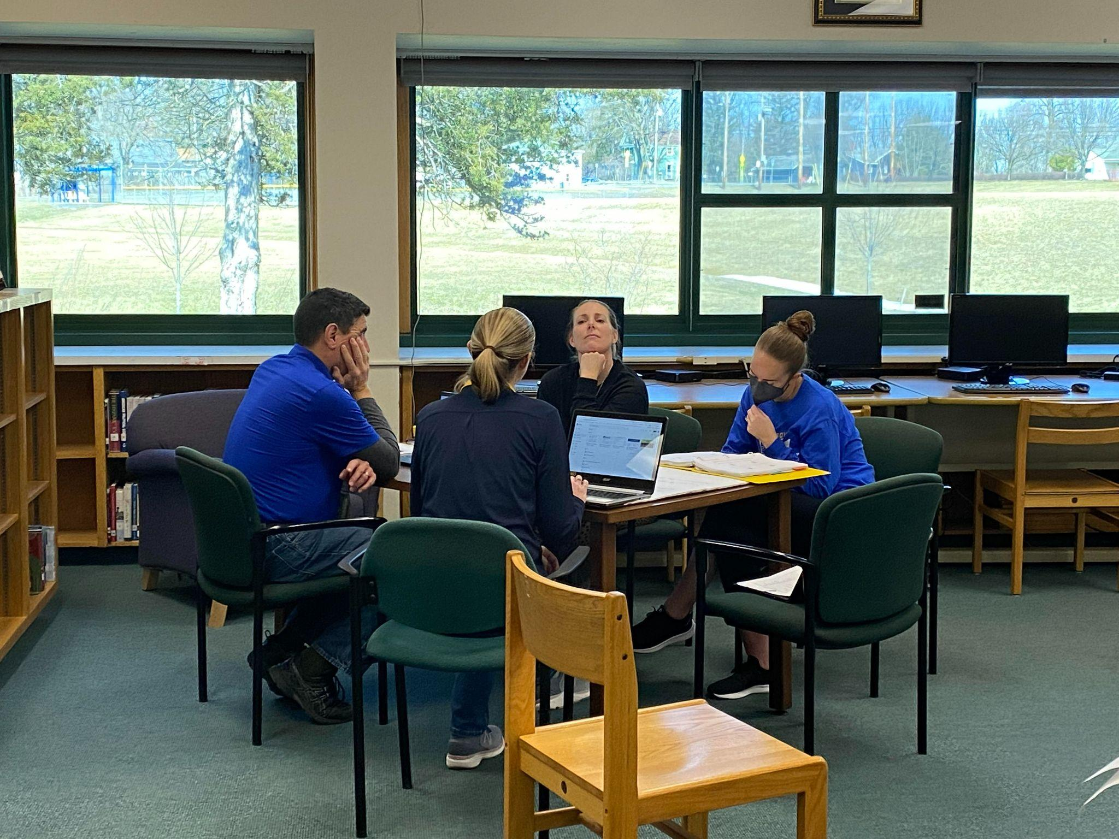
District Technology Committee Update:
This Year District Technology Committee is Focusing on:
Making Recommendations for Updating Policies & Plans (Developing a Software Form and AI Policy).
Developing District Technology Surveys for Students, Staff and Families for the next 3 Year District Technology Plan 2026-2027, 2027-2028, 2028-2029.
Exploring Instructional Technology Resources (examples may include: Digital Citizenship, Digital Media, Gaming).
Updating Cyber Security Incident Response Plan.
Questions?

Slide 15
Overview of Smart Schools Investment Plan
By: Dr. Pennyman-Superintendent, Cheryl Rabinowitz-Manager of Instructional Technology
Tyler Kritzman-Facilities

Slide 16
Overview of Smart Schools Bond Act
The Smart Schools Bond Act, was approved by New York State voters in 2014, authorized the issuance of $2 billion of general obligation bonds to finance improved educational technology and infrastructure to improve learning and opportunity for students throughout the State.
Allocation for Hudson City School District is: $1,771,233.
Collaborative Process (Stakeholders, Assessment of Needs, Demonstrations, Walkthroughs. Recommendations & Develop a Smart Schools Improvement Plan (SSIP))
Focus Areas: High Tech Security Features & School Connectivity

Slide 17
Overview of Smart Schools Bond Act
SSIP must be Aligned with the Approved District Technology Plan.
Aligned with District Technology Plan -Goal 4:
Ensure fully functioning robust network with, equitable, accessible and security technology* to use in school and beyond as applicable. (Technology in this goal includes but is not limited to network infrastructure of upgraded and implementation of wireless access points, administrative software, integration into the network for upgrading security camera and phone systems.)
Recommendations for SSIP: (Upgrades to our Security Camera, Wireless, Phones, PA Systems, Structured Cabling)

Slide 18
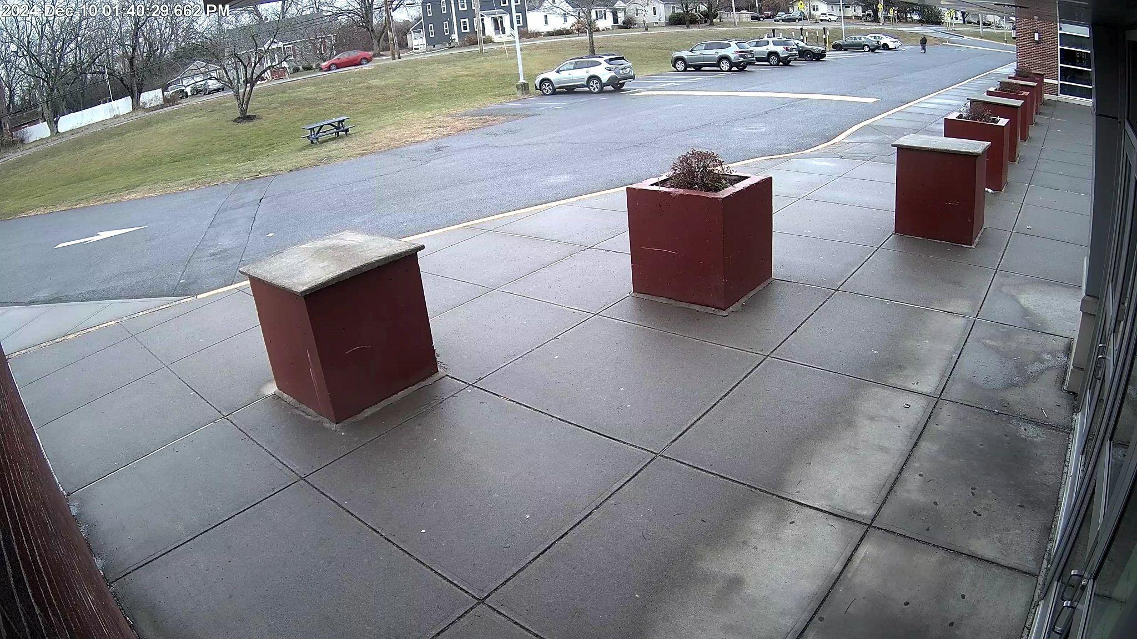
SECURITY & CAMERA UPGRADES PHASE 1
2023/24
Provide new server and VMS licenses for the new video management platform.
(1) 160TB Server & Software
Licenses to ingest all existing cameras
Provide and install (16) new cameras with new cable runs. Includes licensing.
(1) Interior 10MP Dual Head Camera
(7) Interior 4MP Dome Cameras
(1) Interior 6MP Dome Camera
(5) Exterior 6MP Dome Cameras
(2) Exterior 8MP Bullet Cameras

Slide 19
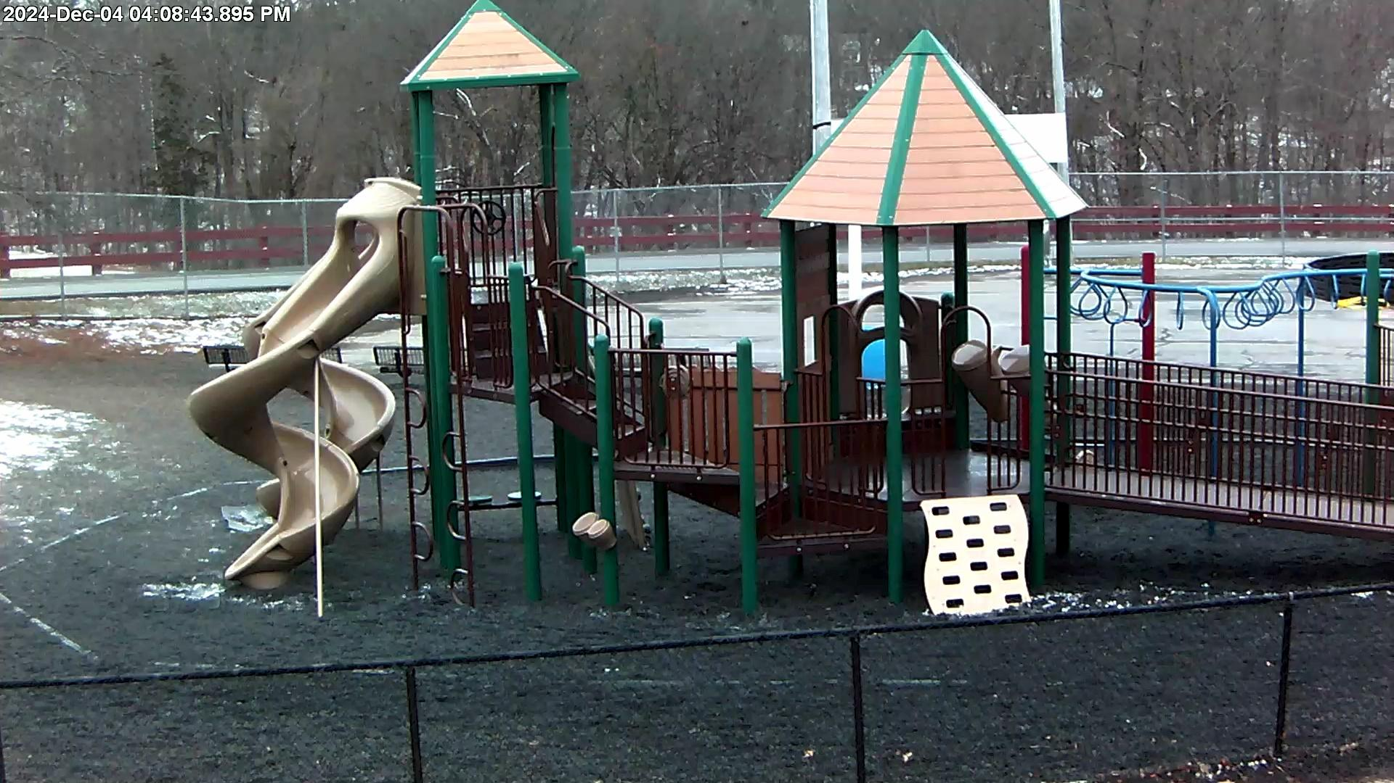
SECURITY & CAMERA UPGRADES PHASE 2
2024/25
Smart Bond
Video Upgrade and Adds
(58) New cameras
(113) Replacement cameras
(1) New 157TB server(MCS)
Access Control Conversion
(1) Access control server
Licenses to ingest (53) doors
(3) New access control doors
(43) New monitored doors

Slide 20
Structured Cabling - Elementary School
(Overview)
New (tested / certified) CAT6A cabling to support the following:
Cisco IP Phone
Meraki Wireless Access Point
Teacher computer
AND (Advanced Network Devices) PA speaker/clock unit
Notes:
Mollie

Slide 21
Structured Cabling - Elementary School
(Components)
(380) Cat6A drops
New patch panels
J-Hooks in hallways
Metal raceways in classrooms
Notes:
Mollie

Slide 22
Cisco Webex Calling
(Overview)
100% Cloud based
Software updates pushed from Cloud
Less on-premise hardware to support and replace
Native support with Singlewire Informacast Notification and Paging integration software (Cloud based)
Call recording
Messaging platform
Business SMS Texting
Softphone native (mobile, Chrome, desktop)
Masks personal mobile number to make school calls
E911 Compliance
Ray Baums Act
Kari’s Law
Alyssa’s Law (NJ, NY, FL)
SPAM Filter
Voicemail Transcription
Language translation
Notes:
Mollie

Slide 23

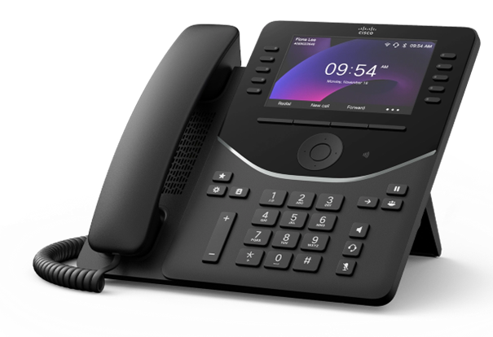

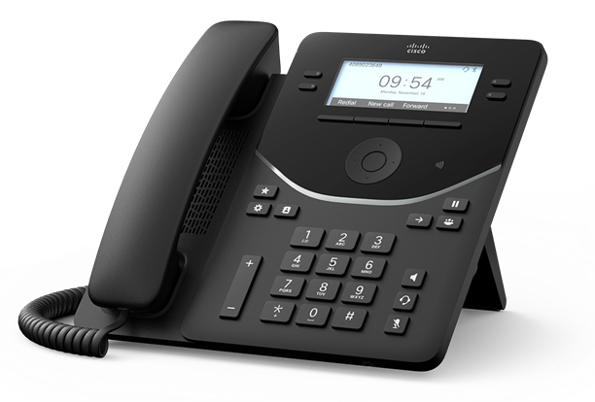

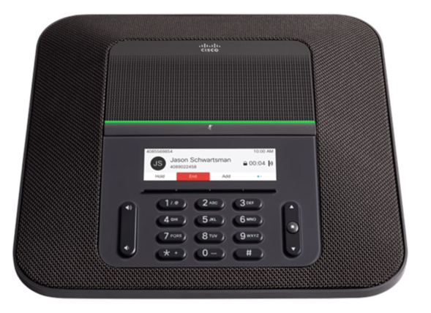
Cisco Webex Calling
(Components)
(275) Cisco A-FLEX-3 licenses
(2) Cisco C8200L voice gateway routers / SRST
(252) Cisco 9841 IP Phones
(59) Cisco 9861 IP Phones
(4) Cisco 8832 IP Phones
Cisco ATA192 analog adapters
Notes:
Mollie

Slide 24
Meraki Wireless
(Overview)
Coverage to include HS/MS/ES and ES athletic field
Streamlined management - Meraki dashboard
Scalability & Resiliency – No WLAN controller to limit network growth
Security - Layer 3 and 7 Firewall Processing Order
Instant access to enhanced features / upgrades
Real-time analytics
Notes:
Mollie

Slide 25
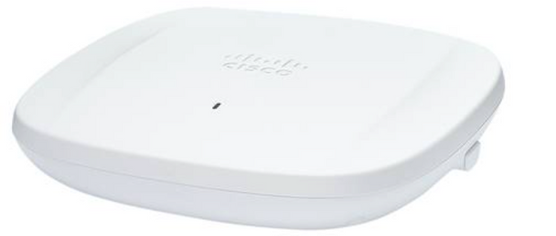
Meraki Wireless
(Components)
(235) Meraki 9162 WAPs (Classroom)
(12) Meraki 9166 WAPs (High Density Space)
(6) Meraki 9163 WAPs (Outdoor)
(1) Meraki MX68 router/security appliance
Meraki 9162
Notes:
Mollie

Slide 26
Public Address / Clock
(Overview)
Upgrades for existing Jr/Sr PA systems
Enhance safety and security with one comprehensive,district-wide platform
Solution integrates with Cisco VoIP phone system
Compatible with approved 3rd party software from Cisco, Singlewire, etc.
Combination clock and PA speaker unit includes high-definition full-color LED display
Singlewire Fusion software provides integrated paging and alert notification
Bell scheduler
Notes:
Mollie

Slide 27


Public Address / Clock
(Components)
Miscellaneous components for upgrade of existing analog PA systems for HS/JR HS (amplifiers, etc.)
(74) Advanced Network Devices PA/clock unit for hallways
Cat6A cables for HS/JR HS
Singlewire Fusion licenses / appliances
Atlas zone controllers
RedSky Horizon E911 license
Notes:
Mollie

Slide 28
Next Steps
Receive Project number from NYSED
Enters SSIP information in the NYSED Portal
A Presentation to School Board of a preliminary Smart Schools Investment Plan.
The preliminary plan will be posted on the district website for at least 30 days.
The district will provide an email address to which any written comments on the plan should be sent.
After the 30 days, the school board conducts a Public hearing that enables stakeholders to respond to the SSIP plan. The district presents final plan for school board approval The final proposed plan that has been submitted has been posted on the district's website. Link to Process

Slide 29
Acknowledgements
For their collaboration & supporting technology for students and staff in the district, a special thank you to:
BOE Members, Superintendent, District and Building Administration, All Instructional and Non-Instructional Staff
Hudson CSD Community,Voters, Partners, Agencies
Hudson CSD Students and their families
District Technology Department
District Technology Committee
All our software and hardware Vendor Partners including the various BOCES (Questar & NERIC & Other BOCES)
Digital Promise,Verizon Innovative Learning Program

Slide 30
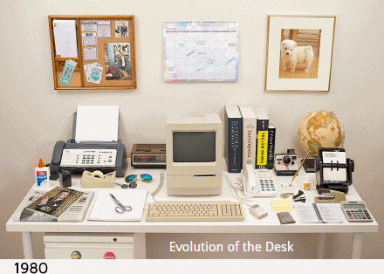
Questions

