Slide 1

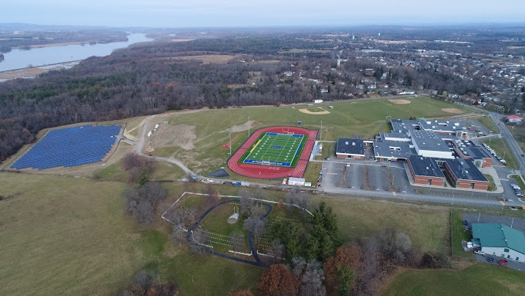

Smart Bond/Smart Schools Investment Plan
(SSIP) Recommendations
By: Dr. Pennyman-Superintendent,
Cheryl Rabinowitz-Manager of Instructional Technology,
Tyler Kritzman- Director of Facilities
May 20, 2025

Slide 2






How Do We Get There?
The Six Keys for School Improvement
 | Strengthen the Instructional Core |  | Strengthen Instructional Leadership Capacity
 | Improve Data Driven Practices |  | Tiered Approach to School Support & Intervention
 | Promote a Positive, Inclusive School Environment for all Stakeholders |  | Increase Monitoring & Accountability
Notes:
Cheryl

Slide 3
Acknowledgements
For their collaboration & supporting technology for students and staff
in the district, a special thank you to:
BOE Members, Superintendent, District and Building Administration,
All Instructional and Non-Instructional Staff and Architect
Hudson CSD Community,Voters, Partners, Agencies
Hudson CSD Students and their families
District Technology Department
District Technology Committee
Smart Schools Sub Committee Members
All our software and hardware Vendor Partners including the various
BOCES (Questar & NERIC & Other BOCES)

Slide 4
Overview of Smart Schools Bond Act
The Smart Schools Bond Act, was approved by New York State voters in 2014, authorized the issuance of $2 billion of general obligation bonds to finance improved educational technology and infrastructure to improve learning and opportunity for students throughout the State.
Allocation for Hudson City School District is: $1,771,233.
Collaborative Process (Stakeholders, Assessment of Needs, Demonstrations, Walkthroughs, Rubric, Pricing, Recommendations & Develop a Smart Schools Improvement Plan (SSIP))
Focus Areas: High Tech Security Features & School Connectivity

Slide 5
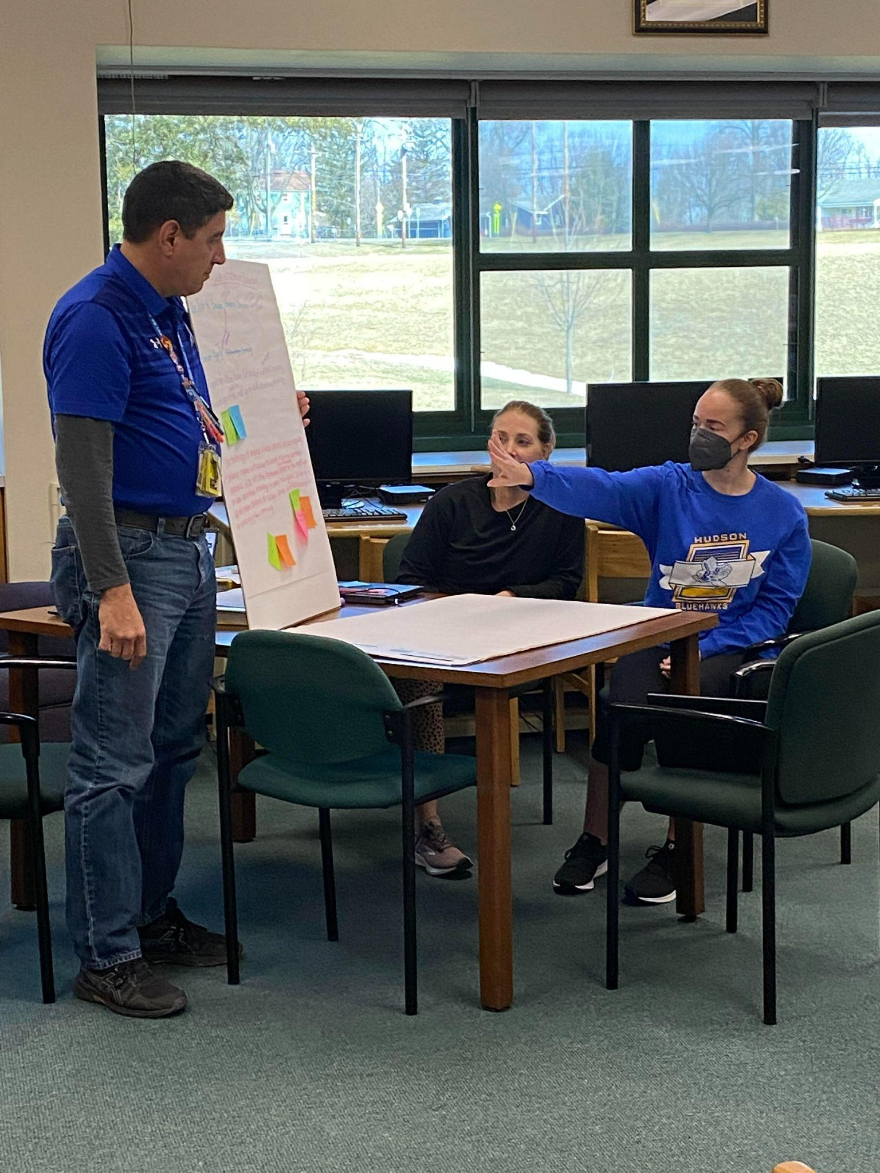
District Technology Committee/Smart Schools Subcommittee
    HCSD has a Very Collaborative Working Committee, Comprised of Students, Parents/Guardian/Community & PreK-12 Faculty, Admin. Support Staff. A Special Thank You to the Committee for All Their Hard Work!
    NYSED Requires School Districts to have a 3 Year Technology Plan.
    Current Plan covers three school years, 2022-2023, 2023-2024, 2024-2025. (Next year will work on New Technology Plan)
    Data Sources Used for Developing Plan:
      IT Audit by the Comptroller’s Office.
      Feedback from Technology Committee Surveys.
      NYS Digital Equity Surveys.
      IT Needs Assessments by IT Dept. & BOCES Partners

Slide 6
District Technology Plan Goals:
Goal 1:
Provide appropriate instructional technology tools to
the school community for teaching, learning, and productivity.
Goal 2:
Provide professional development to teachers, administrators and support staff.
Goal 3:
Ensure student proficiency in digital technology tools and digital citizenship literacy.

Slide 7
Goal 4:
Ensure a fully functioning robust network with equitable, accessible
and security technology.
Recommended Actions for Using our Smart Schools Funding:
Upgrading Wireless Network infrastructure (cabling and access points)
Upgrading the Security camera system and door access.
Upgrading the Phone system.
Upgrading the Public Announcements/Clocks System

Slide 8
Overview of Smart Schools Bond Act
SSIP must be Aligned with the Approved District Technology Plan.
It is aligned with District Technology Plan -Goal 4:
  Ensure fully functioning robust network with, equitable, accessible and security technology* to use in school and beyond as applicable. (Technology in this goal includes but is not limited to network infrastructure of upgraded and implementation of wireless access points, administrative software, integration into the network for upgrading security camera and phone systems.)
  Our Recommendations for Smart Schools Investment Plan: (Upgrades to our Security Camera, Wireless, Phones, PA and Clock Systems, Door Access and Structured Cabling)

Slide 9
Challenges/Issues and Feature/Benefits
Projects | Challenges/Issues | Features and Benefits
Wireless Upgrade (SSIP Area: School Connectivity) | Current environment includes obsolete equipment Coverage gaps Performance | Improved Speeds Increased density (coverage) Cloud based controller (eliminates need for premise based controller upgrades) Bolsters computerized testing/ (CBT) & Teaching and Learning & Work Producivity
Security Camera Upgrade (SSIP Area: High Tech Security Features) | Blind Spots Bandwidth Software | Camera Additions & MCS Server. Camera quality improvement (resolution) Intuitive user interface
Security Door Access Upgrade (SSIP Area: High Tech Security Features) | Doors Secured | 43 Additional Monitored Doors. Notifications
Notes:
Mollie

Slide 10
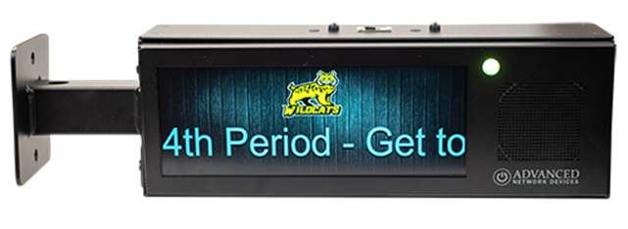
Challenges/Issues and Feature/Benefits
Projects | Challenges/Issues | Features and Benefits
Phone System Upgrade (SSIP Area: High Tech Security Features) | Increasing costs to maintain current system (Service Calls, Resets, etc.) Isolated from other security related solutions | Predictable operational costs Cloud-based call control a. Eliminates costly upgrade-premise based servers b. Instant access to mfgr. feature/upgrades Integrates with districts security and PA systems (Singlewire Fusion, etc.)
Cabling Upgrade (SSIP Area: School Connectivity) & High Tech Security Features) | Antiquated Slower speeds Coverage gaps | Enhanced reliability Increased speeds Improved coverage
PA System/Clocks Upgrade (SSIP Area: High Tech Security Features) | Current system is antiquated/ at maximum capacity (volume issues reported) Unpredictable expense for service calls Issues with bells | Ubiquitous, quality coverage Integrated Bell Scheduler (via Singlewire Fusion) Mass Notification (via Singlewire Fusion)
Notes:
Mollie

Slide 11
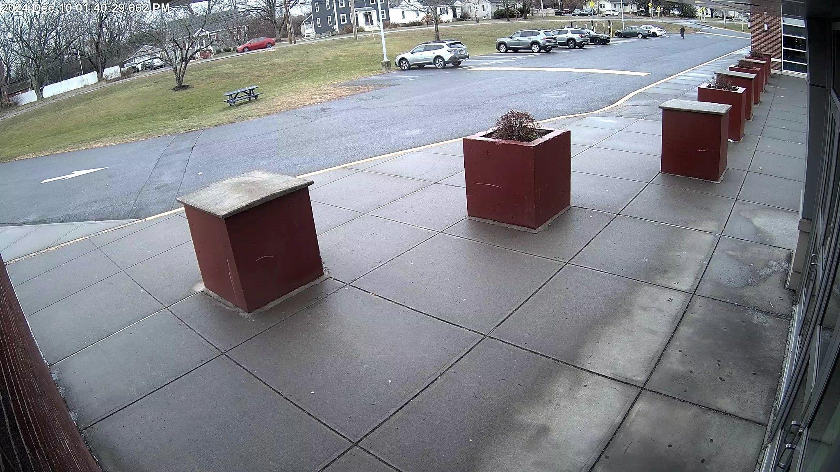
SECURITY & CAMERA UPGRADES PHASE 1
2023/24
Provide new server and VMS licenses for the new video management platform.
  (1) 160TB Server & Software
  Licenses to ingest all existing cameras
Provide and install (16) new cameras with new cable runs.
Includes licensing.
  (1) Interior 10MP Dual Head Camera
  (7) Interior 4MP Dome Cameras
  (1) Interior 6MP Dome Camera
  (5) Exterior 6MP Dome Cameras
  (2) Exterior 8MP Bullet Cameras

Slide 12
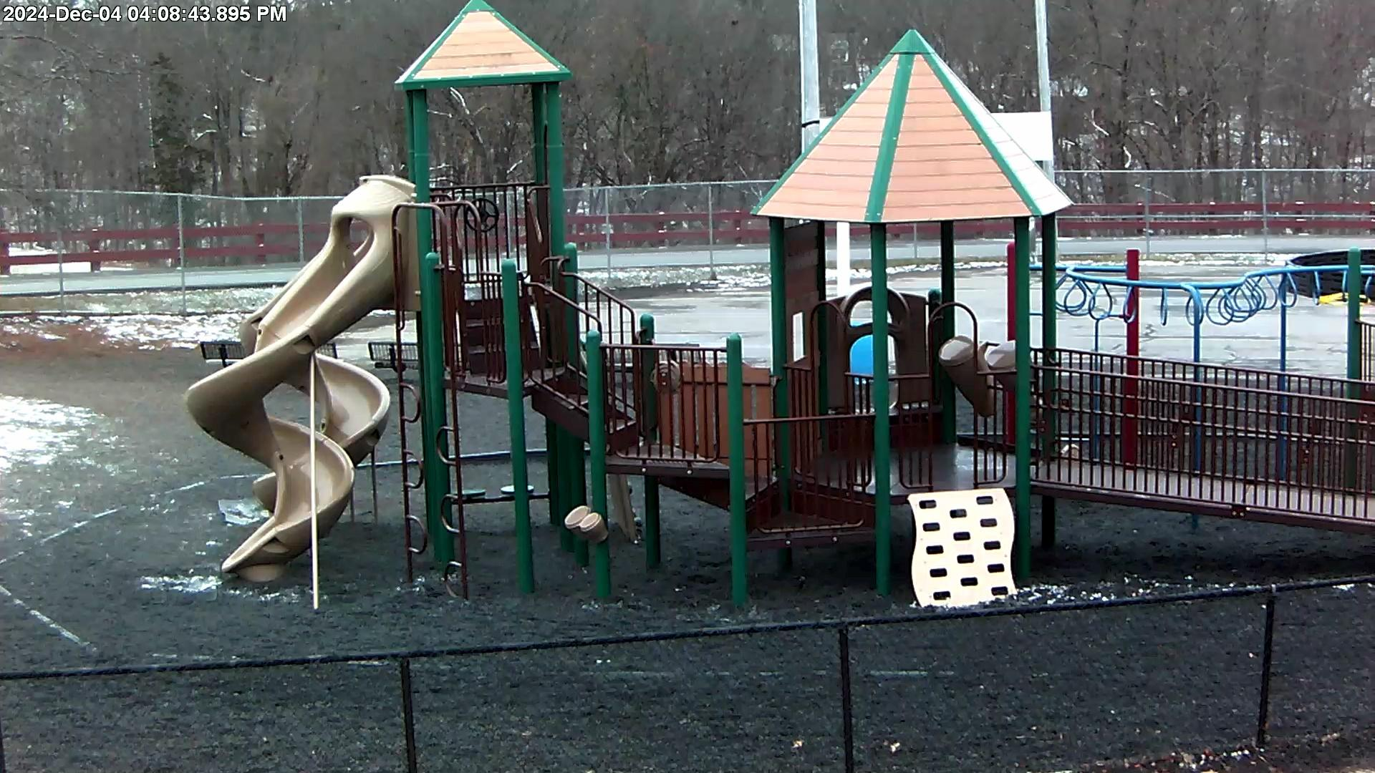
SECURITY & CAMERA UPGRADES PHASE 2
2024/25
Smart Bond
Video Upgrade and Adds
  (58) New cameras
  (113) Replacement cameras
  (1) New 157TB server(MCS)
Access Control Conversion
  (1) Access control server
  Licenses to ingest (53) doors
  (3) New access control doors
  (43) New monitored doors

Slide 13
Structured Cabling - Elementary School
(Overview)
  New (tested / certified) CAT6A cabling to support the following:
Cisco IP Phone
Meraki Wireless Access Point
Teacher computer
AND (Advanced Network Devices) PA speaker/clock unit
Notes:
Mollie

Slide 14
Structured Cabling - Elementary School
(Components)
(380) Cat6A drops
New patch panels
J-Hooks in hallways
Metal raceways in classrooms
Notes:
Mollie

Slide 15
Cisco Webex Calling
(Overview)
  100% Cloud based
  Software updates pushed from Cloud
  Less on-premise hardware to support and replace
  Native support with Singlewire Informacast Notification and Paging integration software (Cloud based)
  Call recording
  Messaging platform
  Softphone native (mobile, Chrome, desktop)
  Masks personal mobile number to make school calls
  E911 Compliance
  Ray Baums Act
  Kari’s Law
  Alyssa’s Law (NJ, NY, FL)
  SPAM Filter
  Voicemail Transcription
  Language translation
  Business SMS Texting
Notes:
Mollie

Slide 16

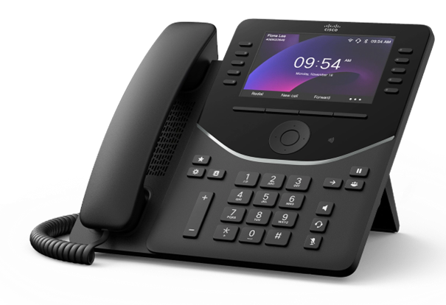

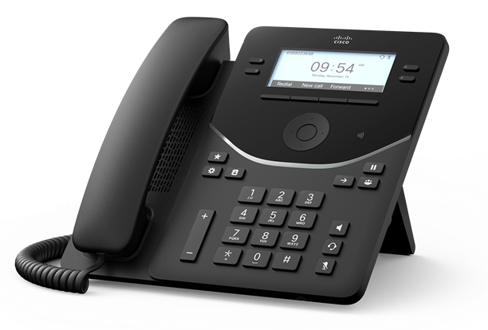

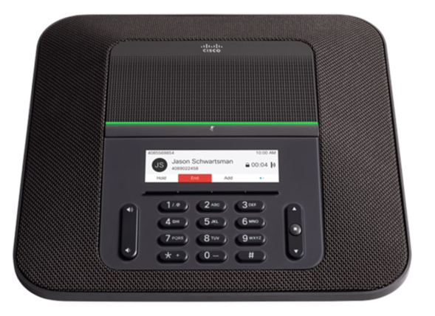
Cisco Webex Calling
(Components)
  (275) Cisco A-FLEX-3 licenses
  (2) Cisco C8200L voice gateway routers / SRST
  (252) Cisco 9841 IP Phones
  (59) Cisco 9861 IP Phones
  (4) Cisco 8832 IP Phones
  Cisco ATA192 analog adapters
Notes:
Mollie

Slide 17
Meraki Wireless
(Overview)
Coverage to include HS/MS/ES and ES athletic field
Streamlined management - Meraki dashboard
Scalability & Resiliency – No WLAN controller to limit network growth
Security - Layer 3 and 7 Firewall Processing Order
Instant access to enhanced features / upgrades
Real-time analytics
Notes:
Mollie

Slide 18
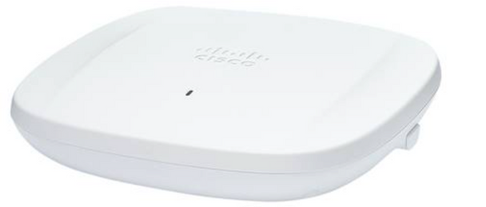
Meraki Wireless
(Components)
(235) Meraki 9162 WAPs (Classroom)
(12) Meraki 9166 WAPs (High Density Space)
(6) Meraki 9163 WAPs (Outdoor)
(1) Meraki MX68 router/security appliance
Meraki 9162
Notes:
Mollie

Slide 19
Public Address / Clock
(Overview)
Upgrades for existing Jr/Sr PA systems
Enhance safety and security with one comprehensive,district-wide platform
Solution integrates with Cisco VoIP phone system
Compatible with approved 3rd party software from Cisco, Singlewire, etc.
Combination clock and PA speaker unit includes high-definition full-color LED display
Singlewire Fusion software provides integrated paging and alert notification
Bell scheduler
Notes:
Mollie

Slide 20
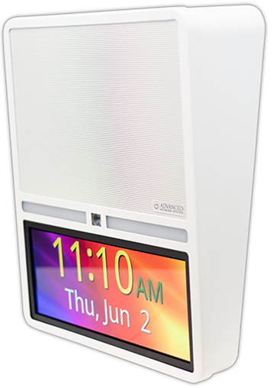
Public Address / Clock
(Components)
Miscellaneous components for upgrade of existing analog PA systems for HS/JR HS (amplifiers, etc.)
(74) Advanced Network Devices PA/clock unit for hallways
Cat6A cables for HS/JR HS
Singlewire Fusion licenses / appliances
Atlas zone controllers
RedSky Horizon E911 license
Notes:
Mollie

Slide 21
Overview of Costs-Smart Schools Budget Breakdown
Project | Area | Cost | Recurring Costs*
Wireless Upgrade | School Connectivity | $271,672.27 | $52,000 for licensing required in year 4, which will cover 3 years (years 4,5,6)
Security Camera Upgrade | High-Tech Security Feature | $619,977.00 | Firmware-Every 3-5 years, $25/camera
Security Door Access Upgrade | High-Tech Security Feature | $100,017.50 | No cost
* Recurring costs subject to change based on MSRP at time of renewal.
**Itemized List by parts and costs, can be found here in the Smart Schools Investment Plan
Notes:
Mollie

Slide 22
Overview of Costs-Smart Schools Budget Breakdown
Project | Area | Cost | Recurring Costs*
Phone System Upgrade | High-Tech Security Feature | $235,364.58 | $32,000 for licensing required in year 4, which will cover 3 years (years 4,5,6) $9,000 for maintenance required in year 2 (handsets) $600 for maintenance required in year 4 (voice gateways)
Cabling Upgrade | High-Tech Security Feature | $339,114.99 | No cost
PA System/Clocks Upgrade | High-Tech Security Feature | $202,718.27 | $19,000 for Singlewire licensing required in year 4, which will cover 3 years (years 4,5,6) $11,000 for Redsky E911 licensing required in year 4, which will cover 3 years (years 4,5,6)
SSIP Total | Total | $1,771.233.00
* Recurring costs subject to change based on MSRP at time of renewal.
**Itemized List by parts and costs, can be found here in the Smart Schools Investment Plan
Notes:
Mollie

Slide 23
Timeline
Submitted Letter of Intent & Received Project number from NYSED
Entered SSIP information in the NYSED Portal. DRAFT will be on district's website
Presentations to School Board of a preliminary Smart Schools Investment Plan. (Overview on January 7th, 2025) (May 20th 2025 Presentation) (June 24th Public Hearing)
The preliminary plan will posted on the district's website for at least 30 days.
An email address has been set up for any written comments and/or questions about the plan. They can be sent to: SmartSchoolsInvestmentPlan@hudsoncsd.org
After the 30 days, the school board conducts a Public hearing, (June 24th, 2025) that enables stakeholders to ask questions/comments about the SSIP plan. The district presents final plan for school board approval. A resolution will be developed to accept the final plan.
The Smart Schools proposed plan will be posted on the district's website, once plan is finalized it submitted through the NYSED portal after the June 24th, 2025 BOE Meeting.
Link to NYSED Process.

Slide 24
Acknowledgements
For their collaboration & supporting technology for students and staff
in the district, a special thank you to:
BOE Members, Superintendent, District and Building Administration,
All Instructional,Non-Instructional Staff and Architect
Hudson CSD Community,Voters, Partners, Agencies
Hudson CSD Students and their families
District Technology Department
District Technology Committee
Smart Schools Sub Committee Members
All our software and hardware Vendor Partners including the various
BOCES (Questar & NERIC & Other BOCES)

Slide 25
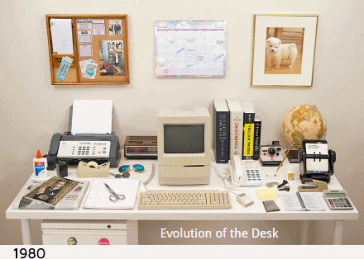
Questions

