Slide 1

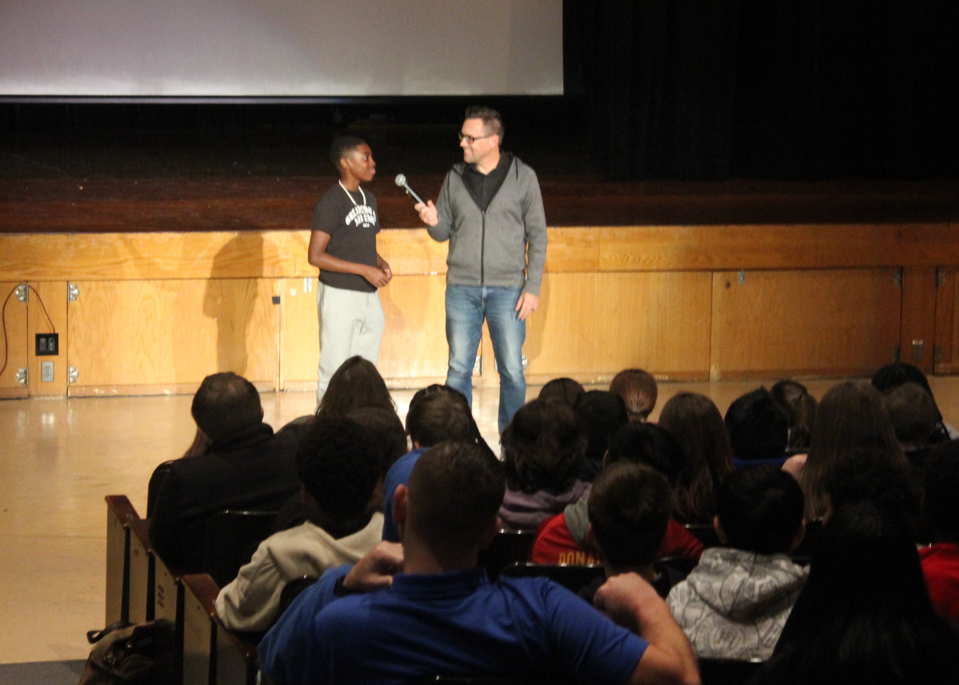
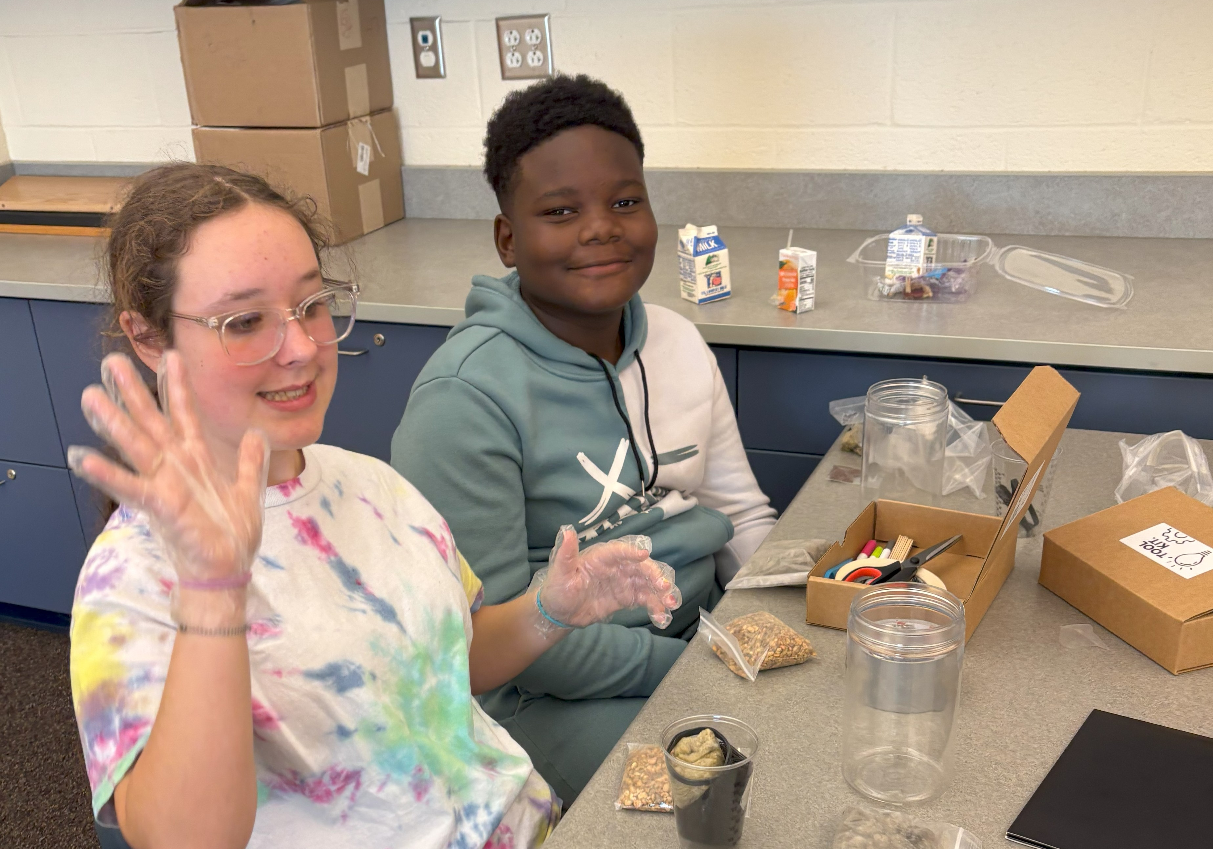
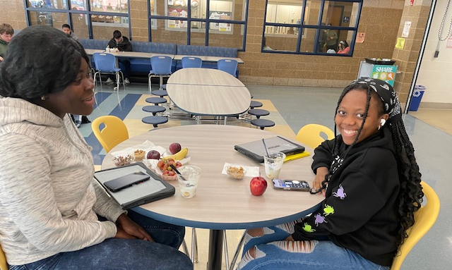

Superintendent’s Report
November 19, 2024

Slide 2
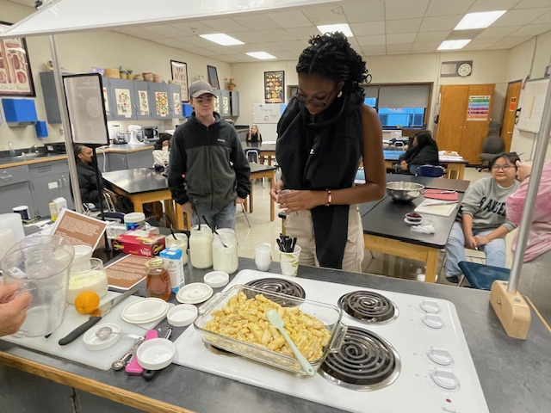
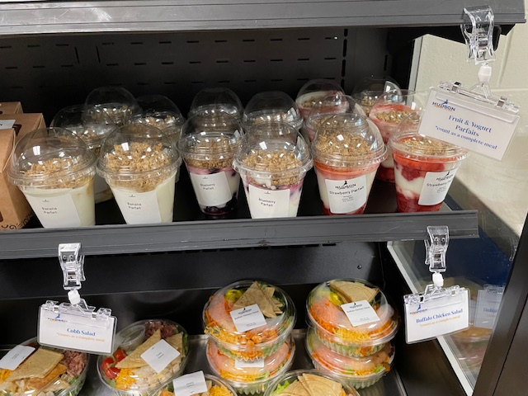
Harvest of the Month: NY Dairy
The Harvest of the Month for November is New York Dairy!
On Wednesday, Nov. 13, Food Service served Upstate Farms assorted flavored yogurt cups at MCSES and Upstate Farms yogurt parfaits in the Jr/Sr High. Breakfast at the Jr/Sr High also included fresh fruit and NY State yogurt bars. The New York State milk is from Sinon Farms.
The Farm to Table Class participated in the Harvest of the Month by having a yogurt-making class, led by School Food Director Lisa McGovern.

Slide 3
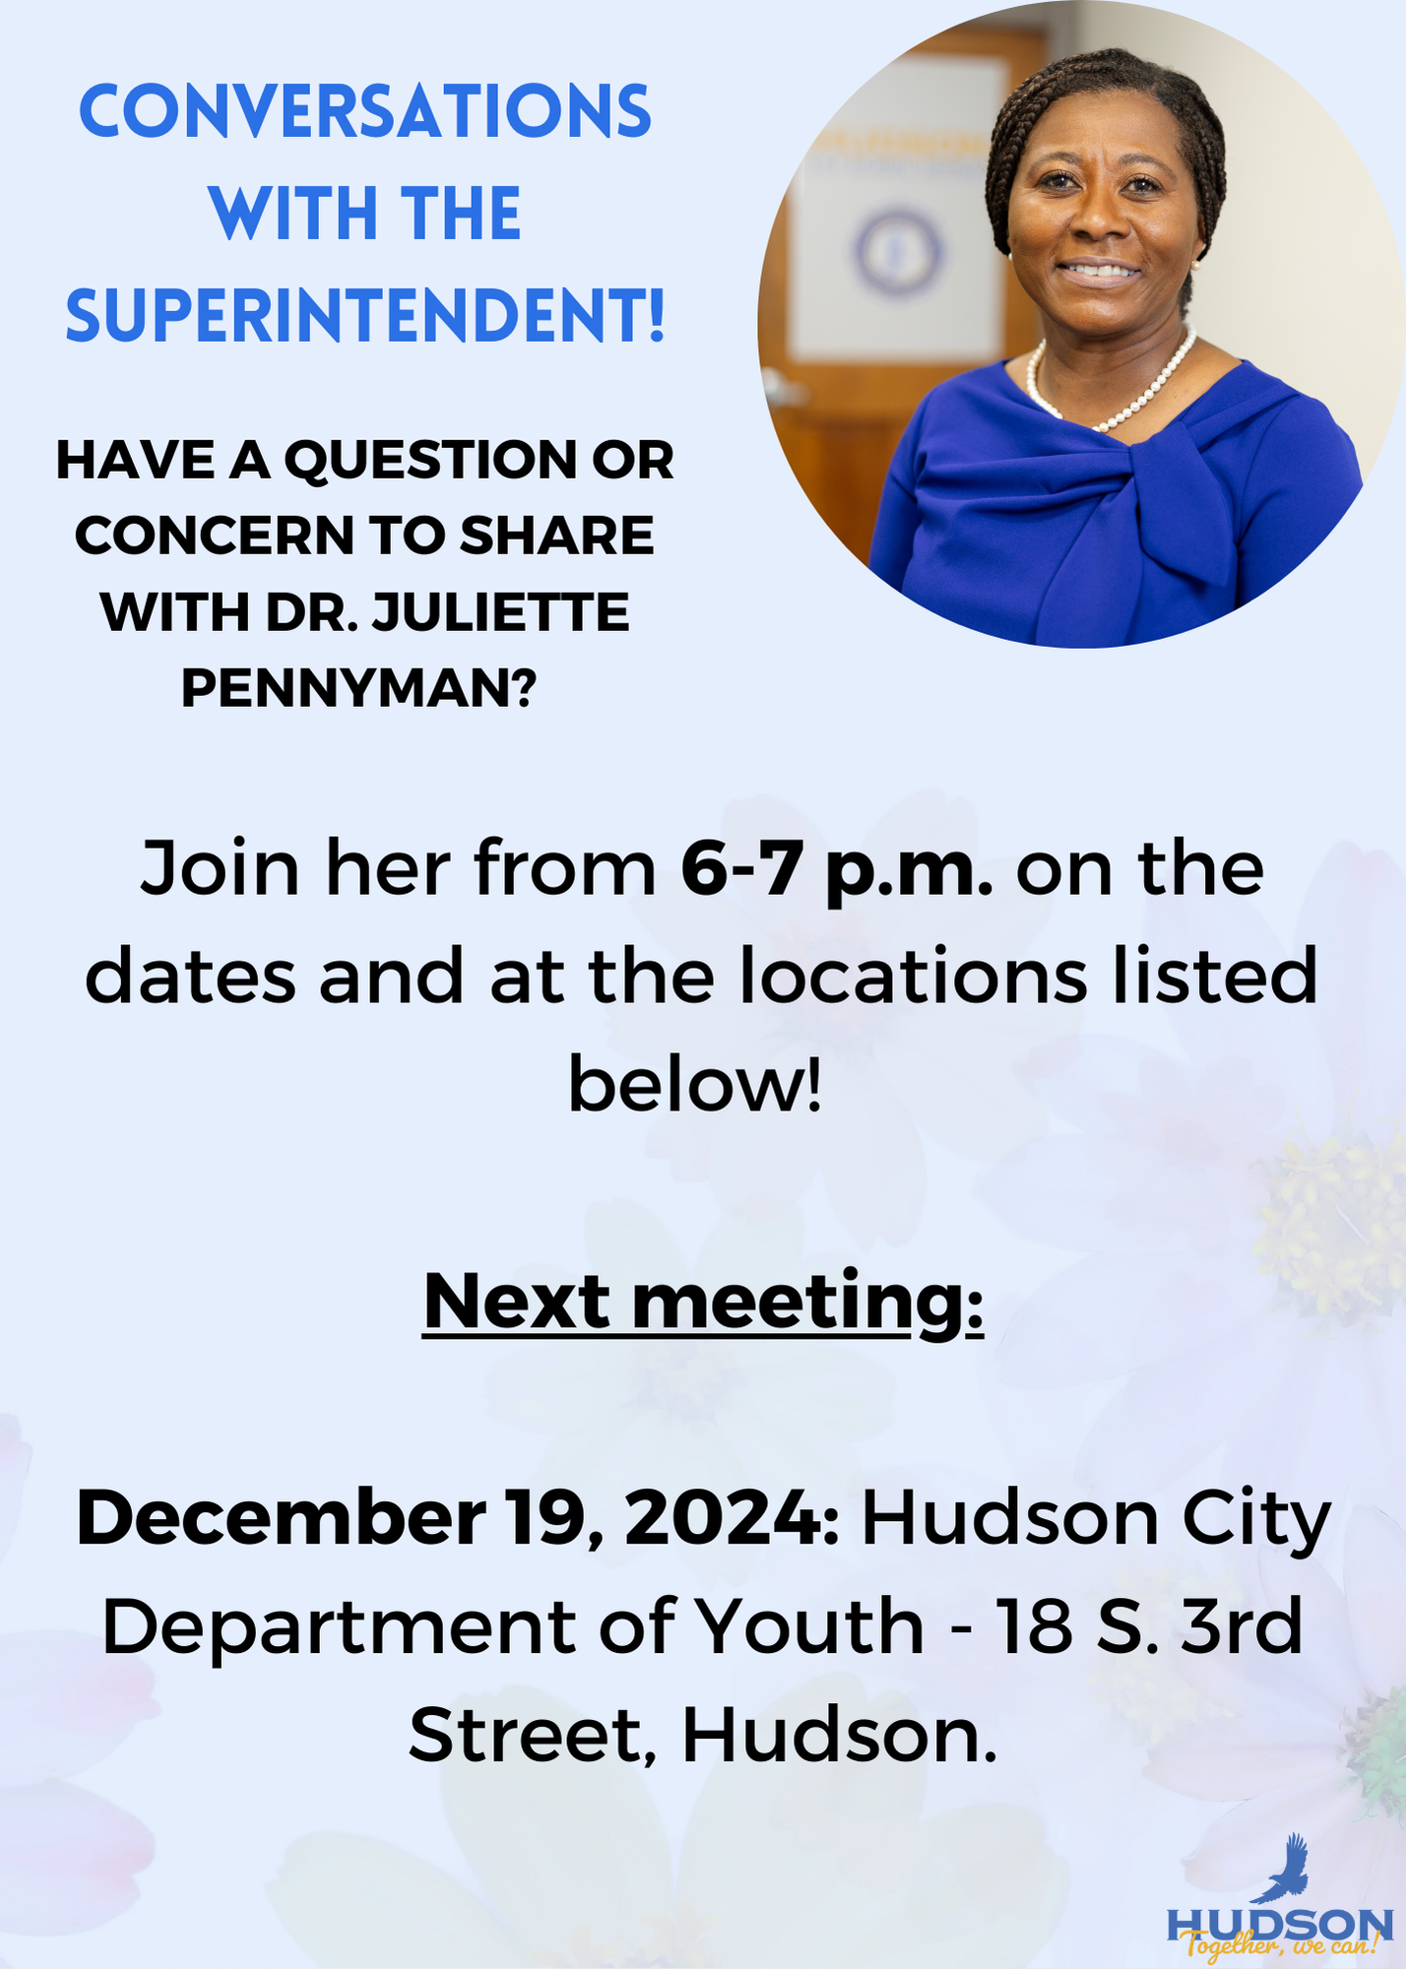
Conversations With The Superintendent
I continue to engage with the community each month as part of my Conversations With The Superintendent forums.
The Nov. 14, 2024 session, attended by several students, included robust discussion about student behavior standards, busing, educational tracks for entering careers in politics and law, and the evolution of Bluehawk Academy’s mission.
The next Conversations With The Superintendent is Thursday, Dec. 19 at 6 p.m. at the Hudson Youth Center, 18 South Third St., Hudson.

Slide 4
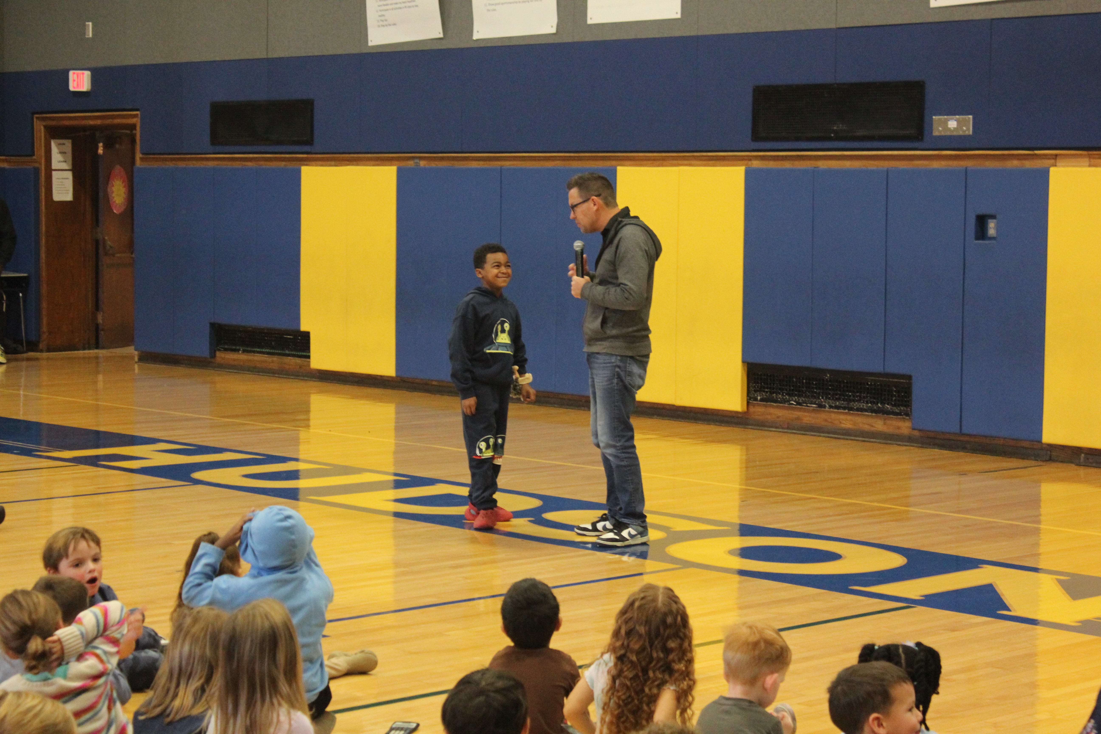
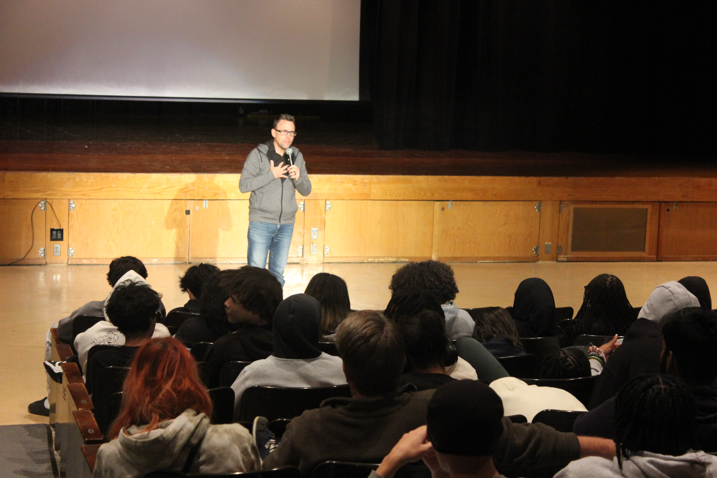
Brooks Gibbs Spoke District-Wide
Brooks Gibbs is a resilience educator with a PhD in Social Psychology. He specializes in teaching youth how to be emotionally resilient and inspires them to live by the golden rule.
On Wednesday, November 13, 2024, the District was honored to host speaker Brooks Gibbs, PhD. Gibbs spoke at all three schools, and he ended the day with a presentation for staff and faculty, families, and community members.

Slide 5
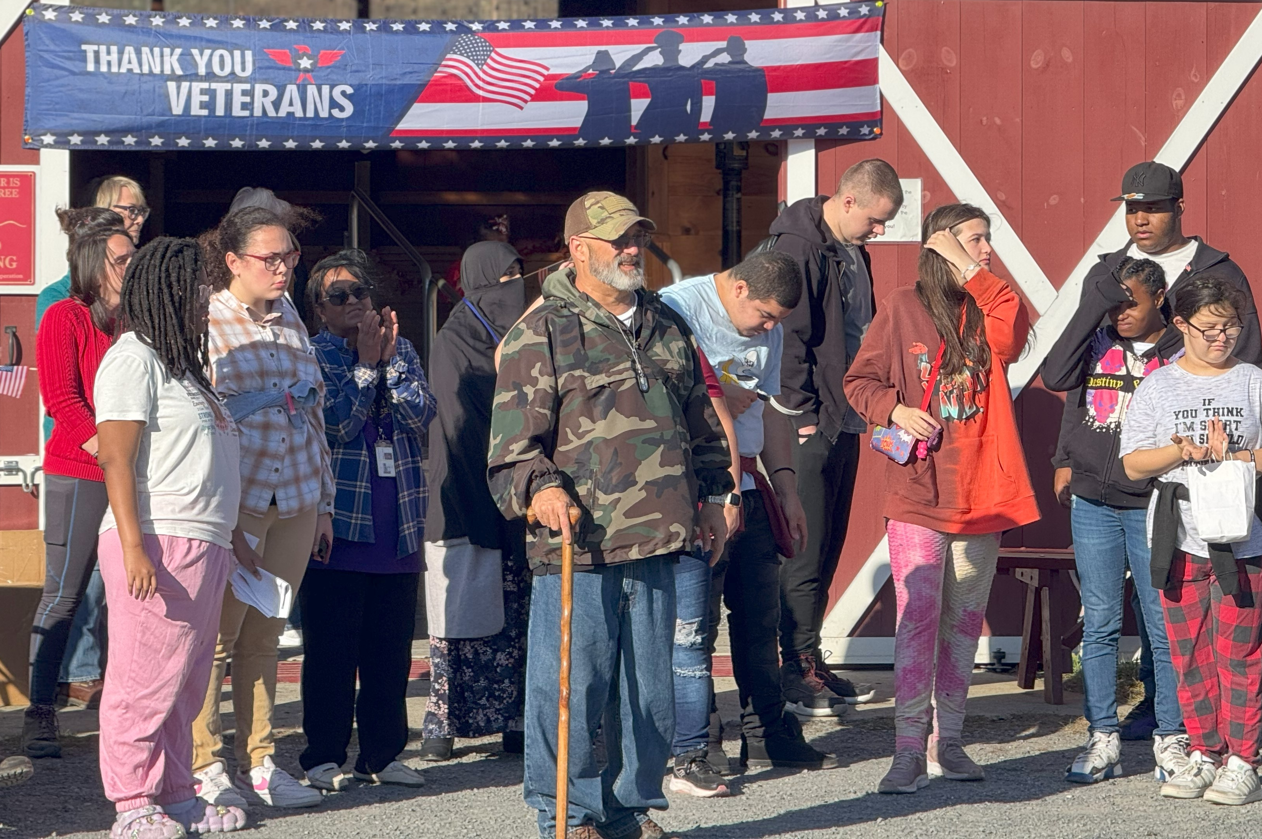
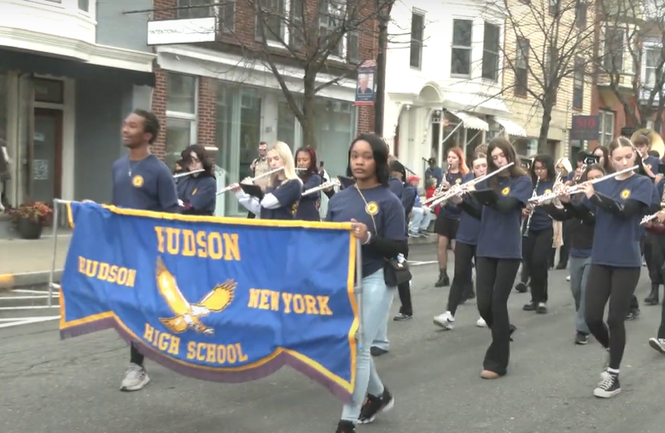
Appreciating and Thanking our Veterans
The SHS Kindness Club under the direction of Lisa Schmitt teamed up with High and Mighty Therapeutic Riding Center, and The Columbia County Veterans Service Agency Dwyer Peer to Peer Program to bring the 4th Annual Veterans Appreciation ‘Bagels at the Barn’.
The event included music from the Hudson Wind Ensemble, tours and gifts from the Life Skills students, bagels, coffee, and fruit. Mr. Lance Wheeler’s Video/Photo Club covered the event.
The Hudson Senior High School Band gave a fantastic performance on Veterans Day on November 11, 2024!

Slide 6
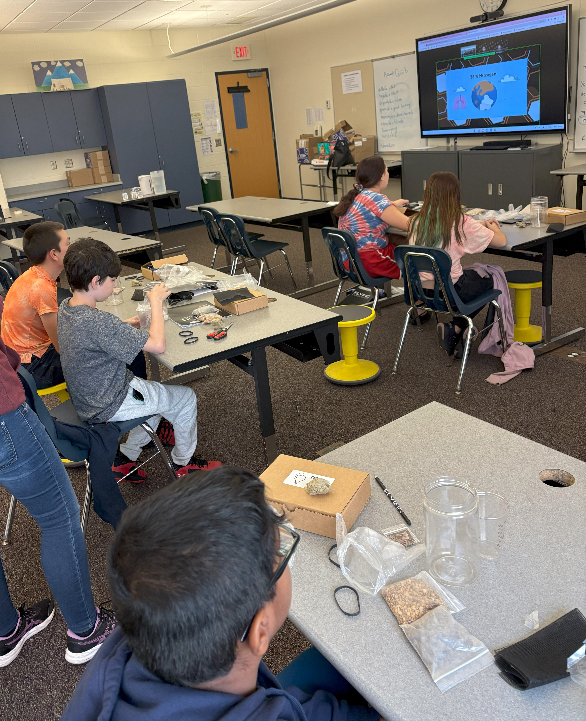
The Flying Classroom has Launched!
A group of Hudson Junior and Senior High School students are receiving hands-on science, technology, engineering and math lessons through the new Flying Classroom Saturday STEM Pilot Program, which successfully launched on Oct. 26, 2024.
Slots are available for additional students to participate for the remainder of the school year.

Slide 7

Superintendent's Spotlight on Excellence

