Slide 1

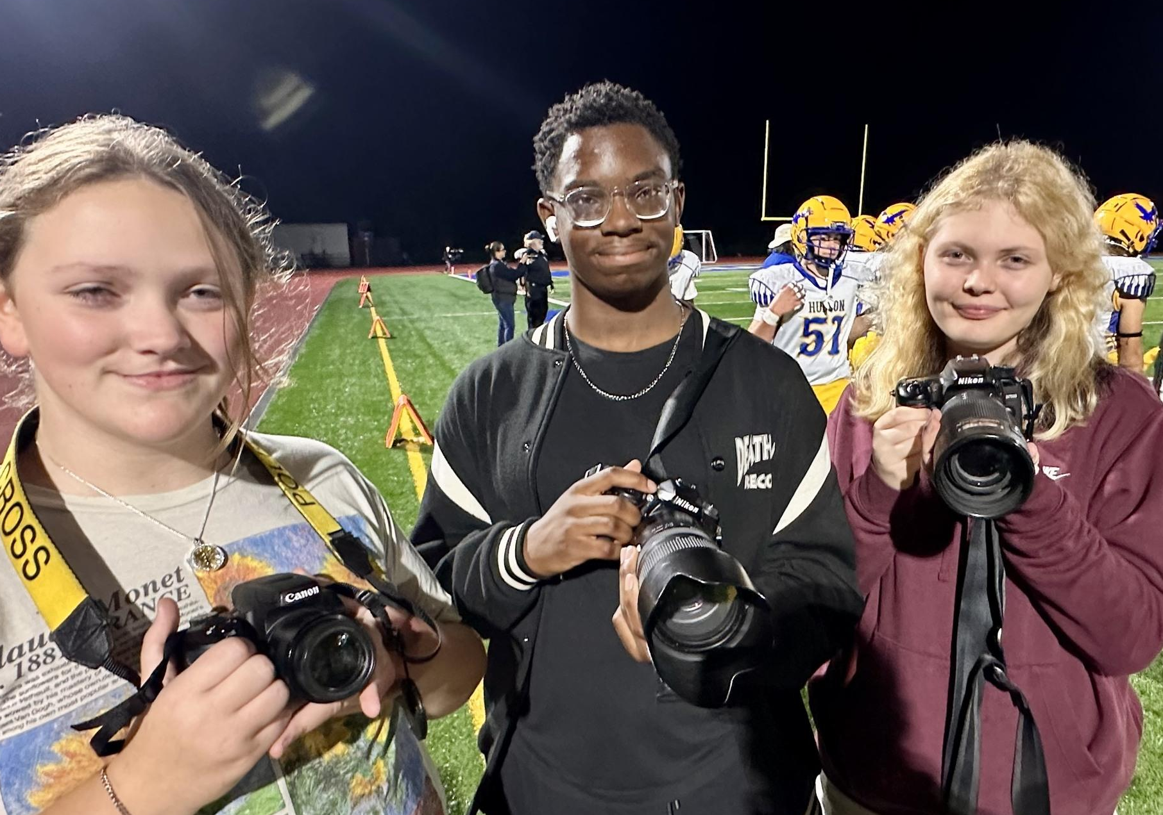
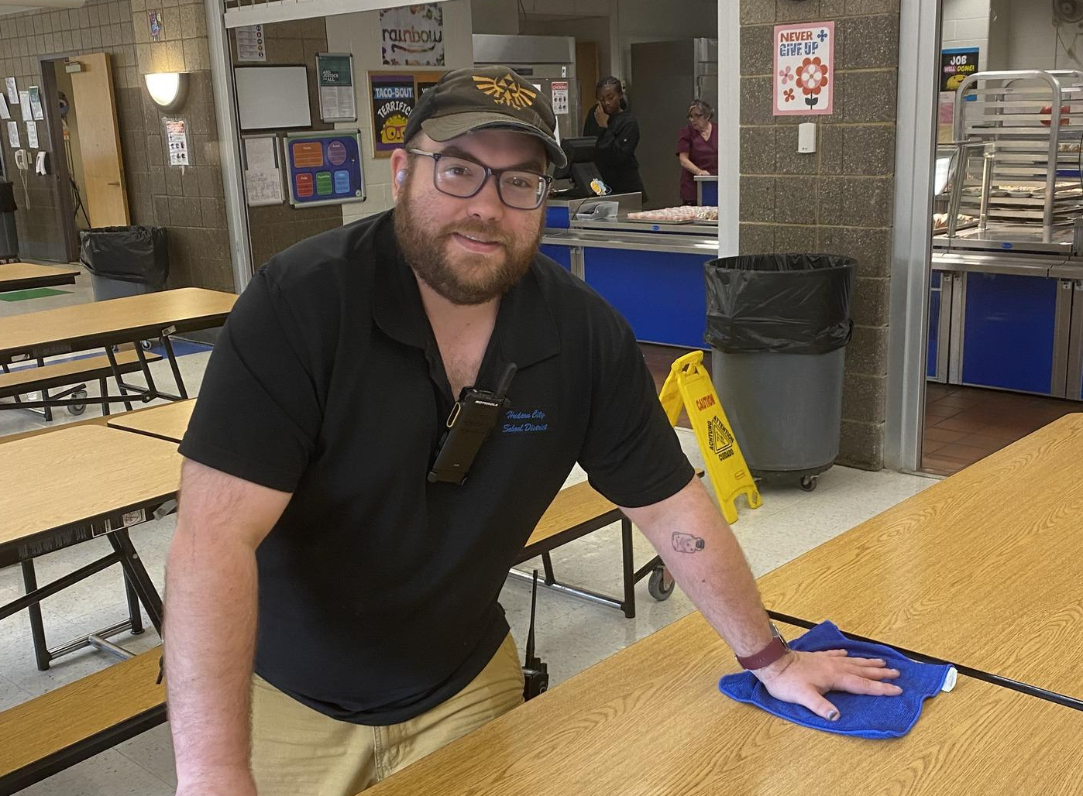
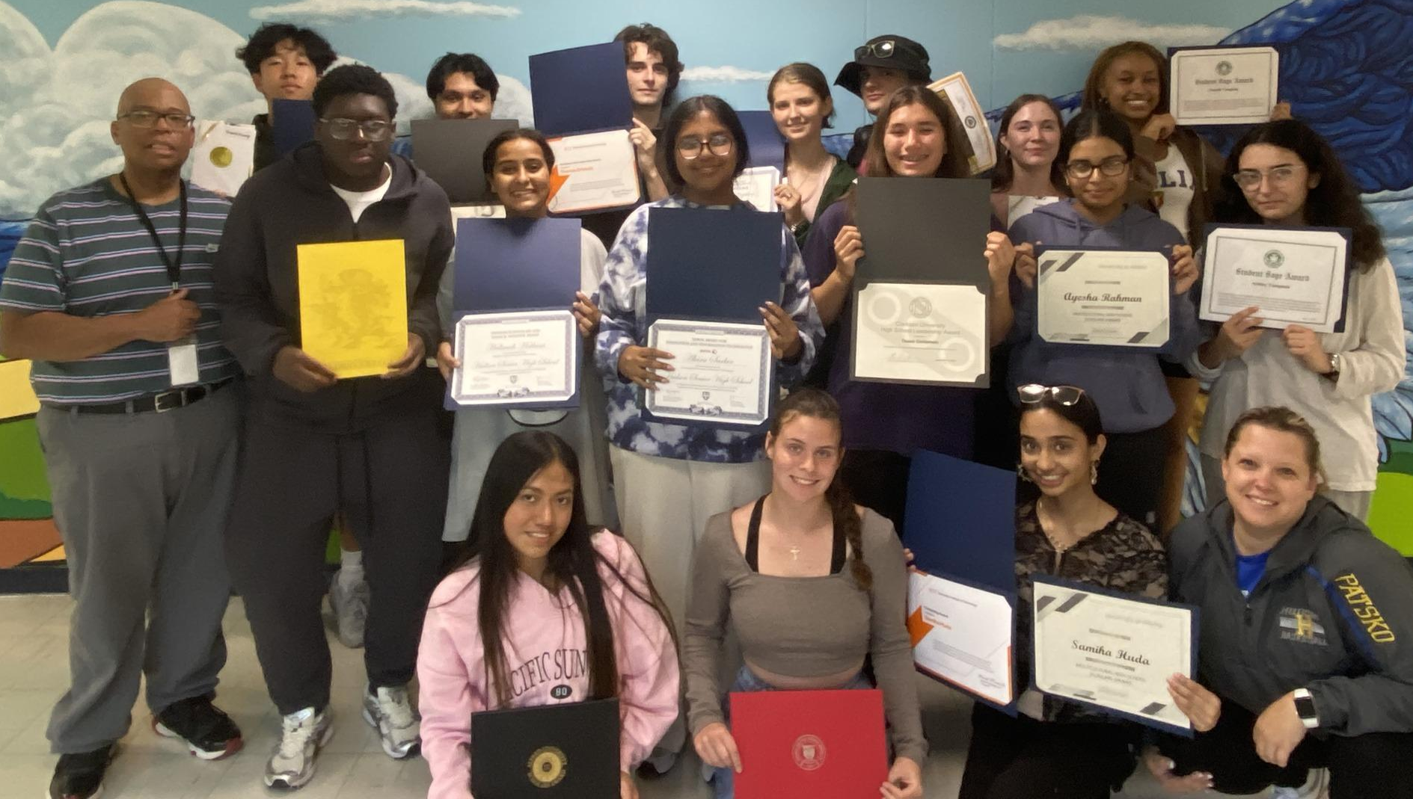

Superintendent’s Report
October 8, 2024

Slide 2
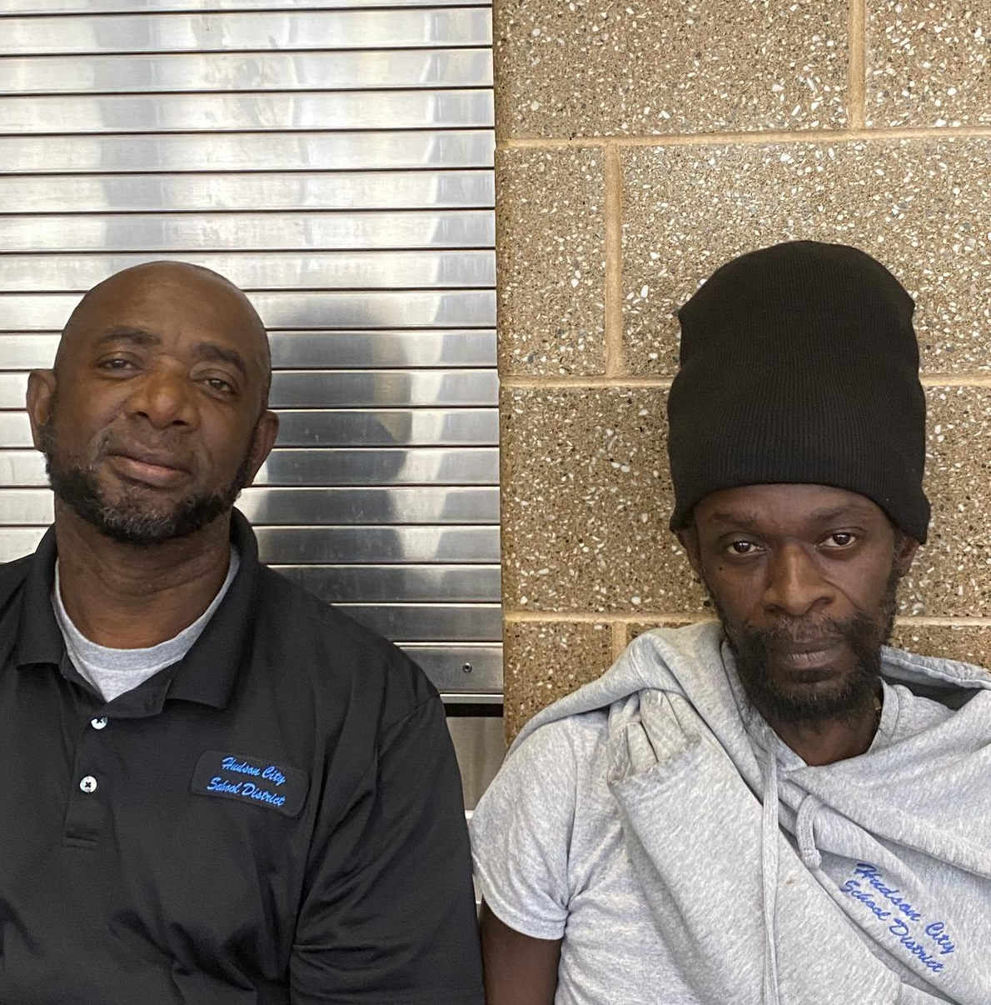

#HudsonTogetherWeCan
10/2 was National Custodian Appreciation Day!
  The District is deeply grateful for all the hard work they put into keeping our facilities clean and comfortable for everyone.
  Their attention to detail in keeping a clean and safe environment is outstanding.
October is National Principals Month, and the District wants to express our heartfelt gratitude to all our principals who lead our schools.
  Their vision and leadership move us forward!

Slide 3

Students’ Reaction to the Bluehawk Cafe
‹#›

Slide 4
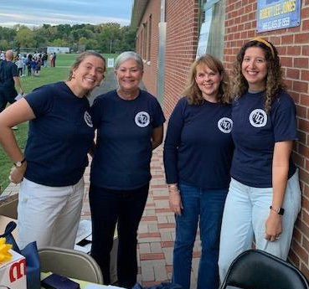

Hudson SHS Homecoming
On September 27, 2024, the Hudson Senior High School held their Homecoming festivities. First, the senior student-athletes were honored with a recognition ceremony. Then, the Homecoming Court and King and Queen were announced and honored. Shortly after that, the Hudson Bluehawks football team played against Cohoes. Also during this time, a few student photojournalists captured wonderful memories with their cameras.
Thanks to the efforts of students, faculty, and staff, this year's Homecoming was a great success!

Slide 5
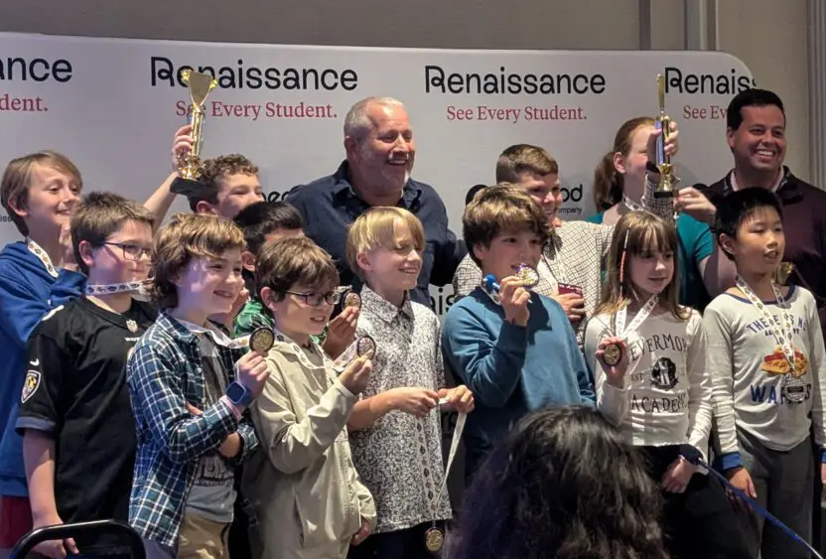
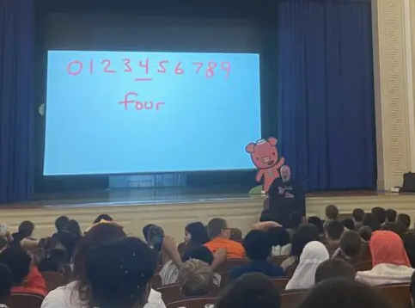
MCSES Students Went to the Capital Region Math Counting Bee
Recently, fifth-grade students competed in their classes to be chosen as their class Math Counting Bee winner. These winners went to the Capital Region Counting Bee in Albany, on 10/2. The 5th grade winners were Dominic, Lennox, and Viviana.
In addition, all students in grades 3-5 were able to see the world-renowned Human Calculator, Scott Flansburg, perform his mathematical magic on Friday, 9/27!

Slide 6

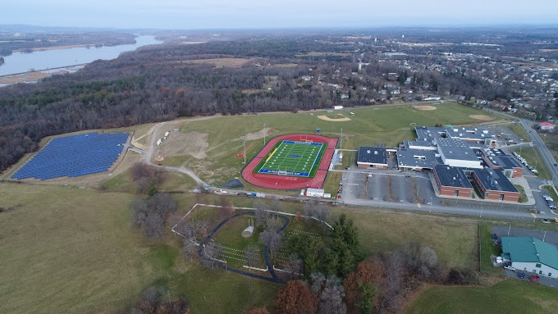

The 2024-2025 Flying Classroom Saturday STEM Pilot Program
Dr. Juliette Pennyman, Superintendent
Dr. Tia L. Pressey, DEI Manager

Slide 7






How Do We Get There?
The Six Keys for School Improvement
 | Strengthen the Instructional Core |  | Strengthen Instructional Leadership Capacity
 | Improve Data Driven Practices |  | Tiered Approach to School Support & Intervention
 | Promote a Positive, Inclusive School Environment for all Stakeholders |  | Increase Monitoring & Accountability
Notes:
Before we get into my observations I want to make sure to share with you the six keys for school improvement that I think are critical for our success here in Hudson.
In my long history in school improvement - I have found that these six keys, if implemented effectively, can dramatically improve schools and instruction across a school and/or district.
We must strengthen the instructional core.
This includes who teaches, how they are supported, and what they teach with instructional materials, in order to have success.
We must also implement data-driven practices.
Everything we spend time doing must be backed up by evidence, and evidence that it will work in our classrooms in order to succeed.
We must also promote a positive, inclusive school environment for all stakeholders.
Without this foundation our students cannot succeed.
We must also strengthen the ability of our instructional leaders to lead teachers and educators in their building in implementing strong instructional practices.
We must meet our students where they are - and tier our supports to schools and students based on their needs.
Finally - we must increase monitoring and accountability.
We must measure where we are in order to effectively improve.
These practices drive my theory of action for how we can improve as a district in serving our students.
I’ll spend a little time on each throughout this presentation sharing my observations of where we are in Hudson in achieving each.
I’ll also discuss how we can take our next steps in the journey in effectively implementing them.

Slide 8
Diversity Equity and Inclusion Mission Statement
At the Hudson City School District, our mission is to support our diverse student body by providing each student with opportunity and access to a high-quality, rigorous, equitable education in welcoming and affirming inclusive environments where students can develop the 21st-century skills needed to thrive in a global society, college, career, and life.
NYSED Office of Attorney General and Commissioner of Education
Statement

Slide 9
What?
We are offering The Flying Classroom STEM Saturday pilot program to our Hudson Junior and Senior High School students!
There are 180-minute modules in each session engaging students in hands-on learning STEM expeditions.
Each module will align to the Next Generation Science Standards.
Each module culminates in a student-led demonstration presentation of the process and the build out of the module.

Slide 10
Why?
As a district, we are committed to equity for each student.
Equity means fair treatment for everyone, regardless of their demographical markers.
MC Smith offers regular STEM activities for students. There are no STEM programs at either the JHS or HHS.
Hudson City School District Policy on Diversity, Equity, and Inclusion
HCSD Policy #105 - Diversity, Equity, and Inclusivity in Education

Slide 11
When?
The Flying Classroom Saturday STEM pilot program will be offered one or two Saturdays monthly from October 2024 to June 2025.
Our kickoff date is October 26, 2024!!!
The schedule is as follows:
9a-10:30a Lesson prep and guided discussion
10:30a - 11a Lunch
11a-12:30p Build out and present completed projects to group
8:30a - 1p District Teacher Workday

Slide 12
Who?
56 Students from grades 6 through grade 12 in four classrooms with 15 students each
To ensure equity, the criteria for choosing participants includes students who represent the racial diversity of our student body:
        American Indian
        African American or Black
        Asian or Hawaiian/Pacific Islander
        Hispanic or Latino
        Multiracial
        White
        Students with IEPs
        English Language Learners (ENL)
        Nonbinary Students (sexual orientation, gender identity, or expression)

Slide 13
Where?
There will be two designated classrooms in the junior high school and two designated classrooms in the senior high school.

Slide 14
What kinds of activities will students engage in?
2024-2025 STEM Project-Based Learning Modules

Slide 15
What is an example of a how each module is based on Next Generation Standards?
Examples of STEM Modules with Next Generation Standards Alignment

Slide 16
How will instruction be delivered?
There will be four virtual teachers, one per classroom, who will go over the prepared lessons step-by-step with the students.
Students will have their individual kits for the lesson.
Students will follow the directions from the virtual teachers.
A teacher and TA, TA and aide, or teacher and aide will circulate the room to ensure students are following directions, to encourage them, or help as needed.
At the end of the lesson, students will present what they made to peers.

Slide 17
Have a great evening, everyone! ☺

